Slide 1
KPK Excise & Taxation system using Shibboleth
FYP-I Defense Presentation
Group Members
Umar Rizwan (15-6023)
Usman Ashraf (15-6016)
Subhan Ahmad (15-6118)
Supervised by
Mr. Fazle Basit
Evaluators
Dr. Muhammad Nauman
Dr. Usman Habib
1 of 11

Slide 2
KPK Excise & Taxation system using Shibboleth
FYP-I Defense Presentation
Outline
Problem Statement
Objectives
Overview of Shibboleth
Single Sign On
Authentication+Authorization
Functionality
Tools
Work Breakdown
Q&A Session
2 of 11

Slide 3
Problem Statement
Objectives
Functionality
Overview
Tools
Work Breakdown
Q&A Session
KPK Excise & Taxation system using Shibboleth
FYP-I Defense Presentation
Problem Statement
The Excise department is engaged in collection of taxes.
They need their Token Taxation & Vehicle Transfer to be centralized.
Original district to be updated automatically.
3 of 11

Slide 4
Problem Statement
Objectives
Overview
Functionality
Tools
Work Breakdown
Q&A Session
KPK Excise & Taxation system using Shibboleth
FYP-I Defense Presentation
Objective
To build a system which can perform following functions:
1. Centralized System by applying Federated Identity
Management (FIM) using Shibboleth.
2. Complete responsive Web Application.
3. Automatic update of Taxation and Transferring of vehicles.
4 of 11

Slide 5
Overview Of Shibboleth
Problem Statement
Objectives
Overview
Functionality
Tools
Work Breakdown
Q&A Session
KPK Excise & Taxation system using Shibboleth
FYP-I Defense Presentation
What?
Web Single Sign-On system
Separates authentication + authorization
Where?
Websites/web applications (+ mobile applications)
eJournals
5 of 11

Slide 6
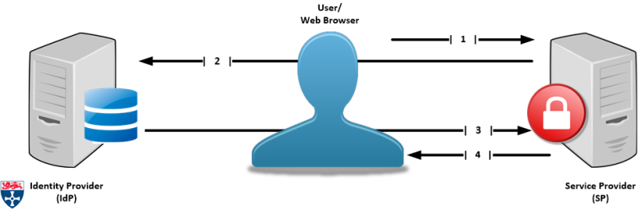
Terminology: Single Sign-on
Problem Statement
Objectives
Overview
Functionality
Tools
Work Breakdown
Q&A Session
KPK Excise & Taxation system using Shibboleth
FYP-I Defense Presentation
It is an authentication process that allows the user to access multiple applications with one set of login credentials.
6 of 11

Slide 7
Authentication Authentication is the process of recognizing a user’s identity. Authorization Authorization is a security mechanism used to determine user/client privileges or access levels related to system resources
Problem Statement
Objectives
Overview
Functionality
Tools
Work Breakdown
Q&A Session
KPK Excise & Taxation system using Shibboleth
FYP-I Defense Presentation
7 of 11

Slide 8
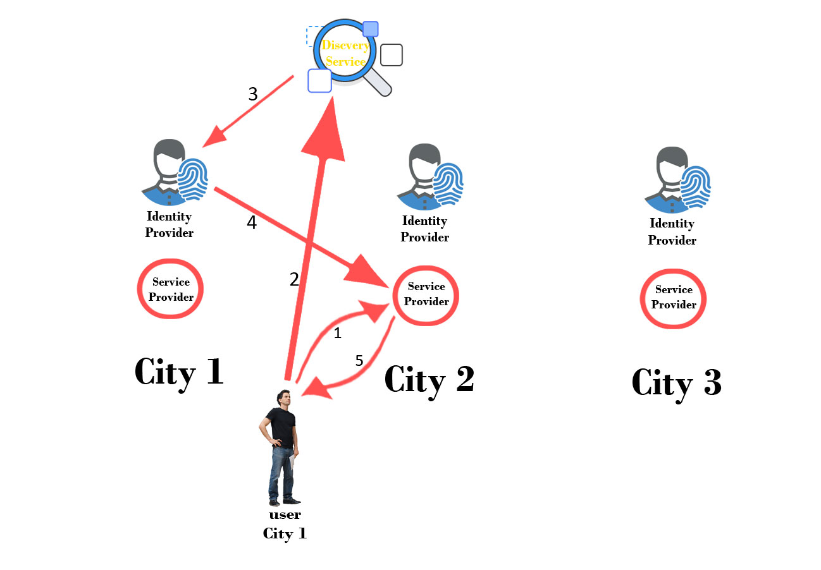
Problem Statement
Objectives
Overview
Functionality
Tools
Work Breakdown
Q&A Session
KPK Excise & Taxation system using Shibboleth
FYP-I Defense Presentation
Functionality
8 of 11

Slide 9
Problem Statement
Objectives
Functionality
Overview
Tools
Work Breakdown
Q&A Session
KPK Excise & Taxation system using Shibboleth
FYP-I Defense Presentation
Tools
PHP
Flask
JSP
SAML
9 of 11

Slide 10
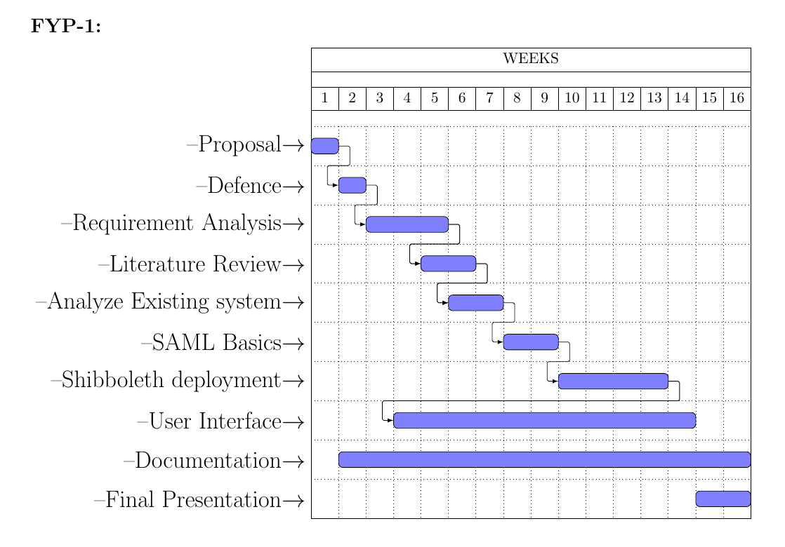
Problem Statement
Objectives
Functionality
Overview
Tools
Work Breakdown
Q&A Session
KPK Excise & Taxation system using Shibboleth
FYP-I Defense Presentation
Work Breakdown
10 of 11

Slide 11

Problem Statement
Objectives
Functionality
Overview
Tools
Work Breakdown
Q&A Session
KPK Excise & Taxation system using Shibboleth
FYP-I Defense Presentation
Q & A
Any Questions
11 of 11

